Slide 2
Project Partnership 2017-2022
Led by the Scottish Wildlife Trust
Funded by the National Lottery Heritage Fund (and LEADER in Dumfries & Galloway)

Slide 3
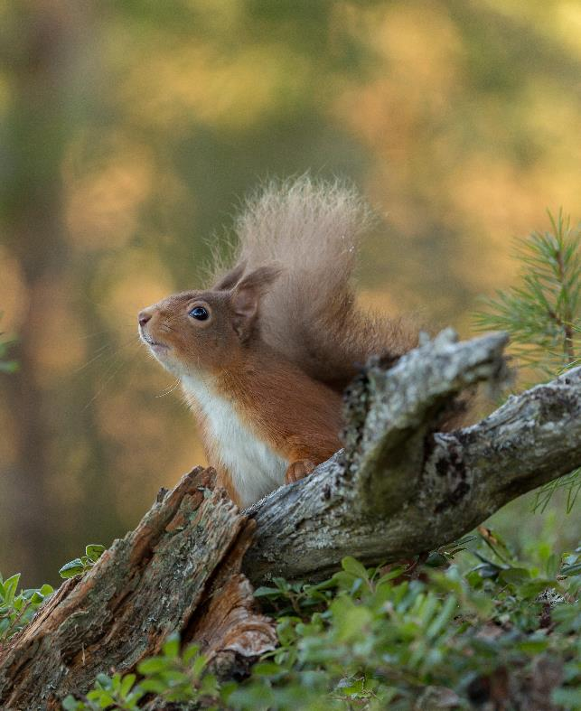
Aims and objectives
Reducing grey squirrel numbers in strategic areas
Population and squirrelpox monitoring
Promoting good practice
Raising awareness
“Developing community action”
© Raymond Leinster

Slide 4
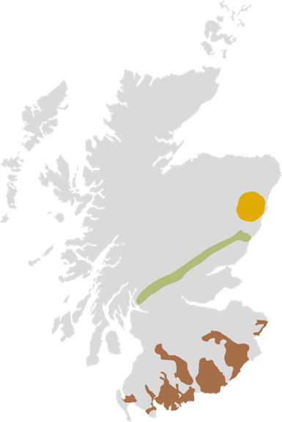
Project areas
North East
Problem: “island” population of greys introduced to Aberdeen in 1970s
Action: eradication programme
South Scotland
Problem: “mosaic” of red and grey populations, frequent squirrelpox outbreaks
Action: targeted control by a network of local volunteer groups
Central Lowlands
Problem: greys spreading north to core Highland populations of reds
Action: targeted control to prevent greys spreading north of the Highland line
Notes:
We’re operating in key areas where our work will have the greatest impact on all of Scotland’s red squirrels
Aberdeen: 1970s, island population, no pox. Control staff working with support from householders as well as landowners eradication is possible
Highland boundary line: prevent greys moving further north, bringing pox into Highlands. A few positive cases in recent years but modelling shows that targeted control will prevent outbreaks in reds. Seasonal control staff, landowners and vols.
South has both species, but more reds than people often think. Pox came from Cumbria about 10 years ago, project was unable to prevent the spread. No longer testing for pox, assumed 100%.

Slide 5
South Scotland PARCs
Notes:
8 PARCS in D&G, Ayrshire, Borders
Teviot & Rule, upper Tweed Valley, Berwickshire
Meet criteria including healthy reds, landowner support, local populations
Targeted control with staff and volunteers

Slide 6
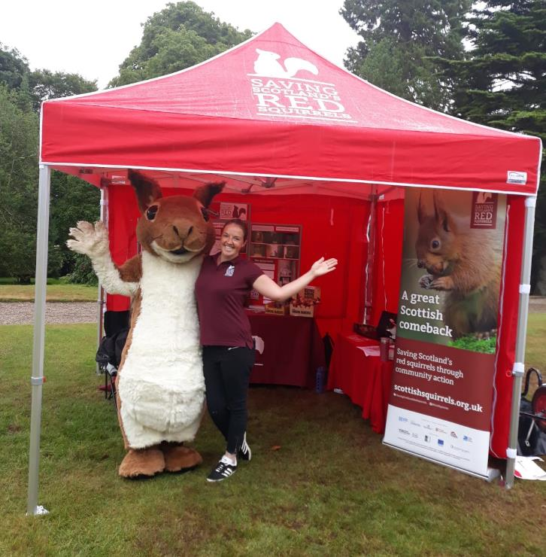
South Scotland team
2 Conservation Officers
4 full-time Grey Squirrel Control Officers (plus seasonal)
2 Community Engagement Officers

Slide 7
Project impact in South Scotland
Halted decline in most project areas
Slowed (but not halted) northward spread of squirrelpox
Allowed reds to thrive where low grey squirrel densities are maintained
© Raymond Leinster

Slide 8
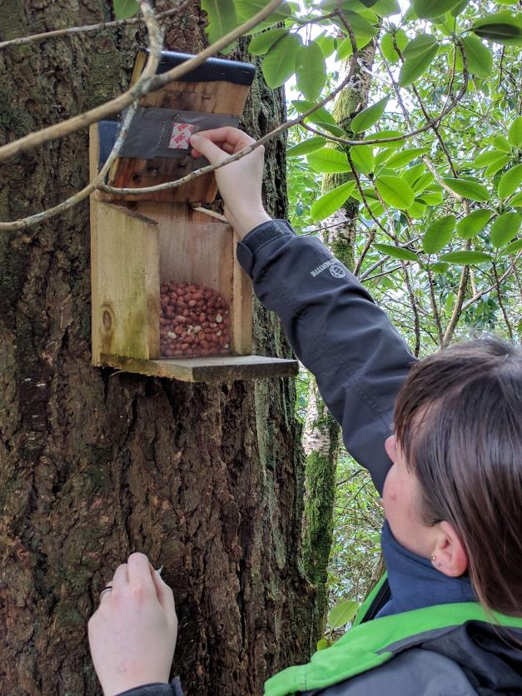
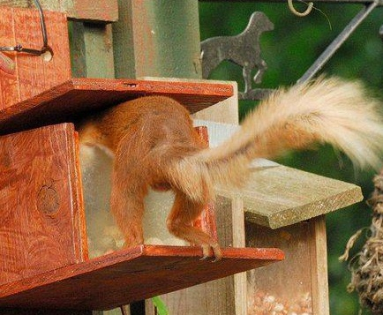
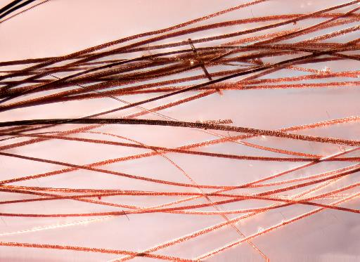
Measuring impact – spring survey

Slide 9
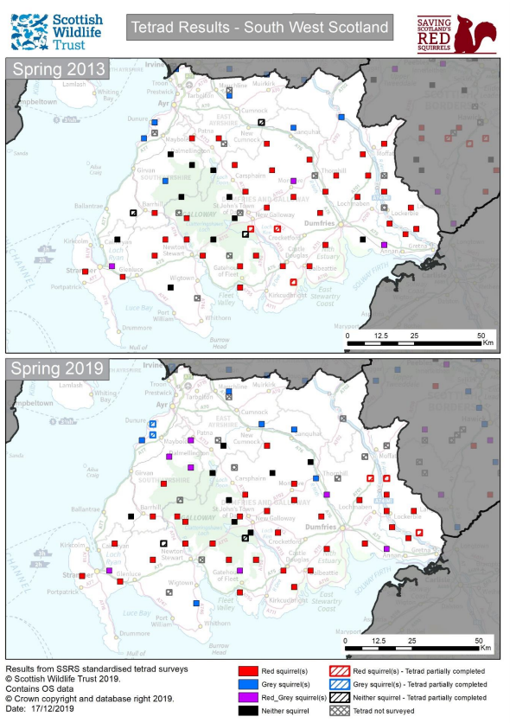
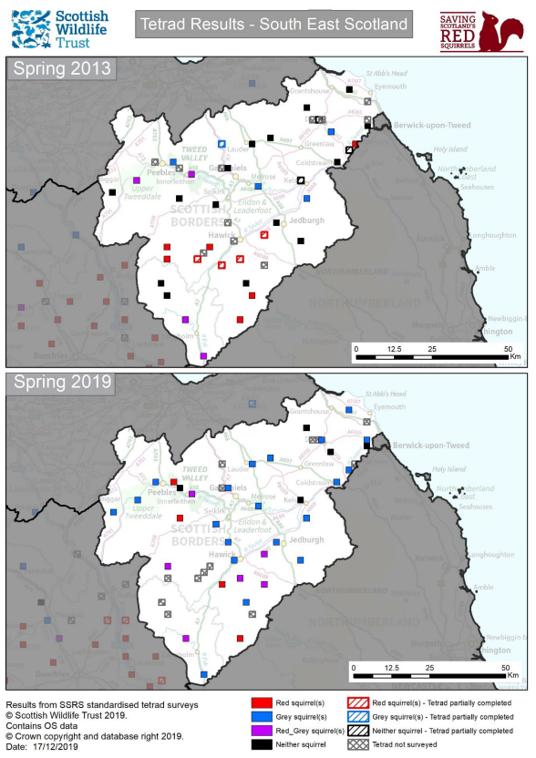

Slide 10
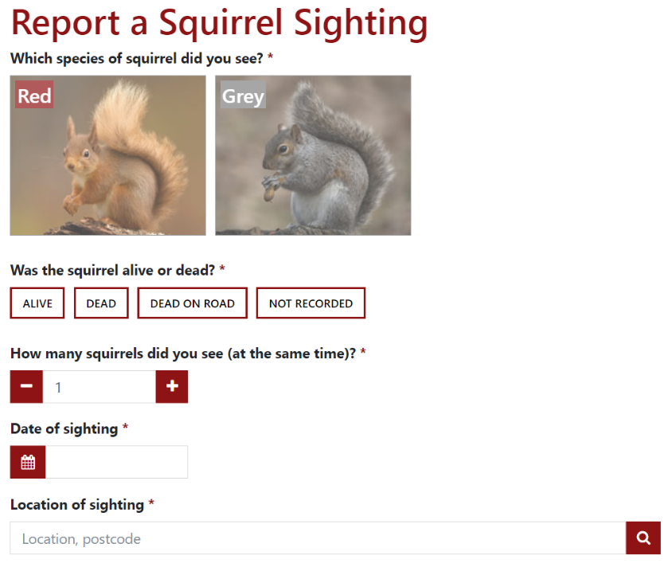
Get involved - sightings
Report your red and grey squirrel sightings at scottishsquirrels.org.uk

